Slide 1


DETECTION OF FAKE NEWS USING ARTIFICIAL INTELLIGENCE
Group No 24:
Rohit 18EE10045
Subham Karmakar 18EE10067
Shirsha Chowdhury 18EE10068
Hrituraj Dutta 18EE35021
Vibhanshu Ranjan 18EE35032

Slide 2

INTRODUCTION
People are more dependent on online sources of information now than ever.
The online sources primarily are social media platforms.
36% dependency in UK
51% dependency in Australia
40% dependency in US
Spread of fake news thus becomes exponential all over the internet(Echo Chamber effect).
They are a threat to democracy and journalism.
Natural Language Processing methods to detect fake news can be easily bypassed.
Research has been going on in this field to use AI techniques to detect fake news.
Subham Karmakar 18EE10067

Slide 3
WHY IS IT SO SERIOUS?
2011
2013
2016
Rumours that Iodised Salt protect humans from nuclear radiation
Rumour about explosion in Whitehouse causing injuries to Barack Obama
Fake US election stories spread on the social media platforms
People raided supermarkets to buy salt
$130 billion in stock market got wiped out
Top 20 Fake stories got more interaction than all true stories combined
Subham Karmakar 18EE10067

Slide 4

METHODS OF FAKE NEWS DETECTION
Knowledge Based
Propagation Based
01
03
Credibility Based
02
Style Based
04
Subham Karmakar 18EE10067

Slide 5





KNOWLEDGE BASED FAKE NEWS DETECTION
(__,__,__)
Redundancy reduction
Invalidity reduction
Conflict resolution
(__,__,__)
(__,__,__)
Open Web
Raw facts/triples
1. FACT EXTRACTION
(__,__,__)
(__,__,__)
(__,__,__)
2. FACT CHECKING
Knowledge-Base
Vibhanshu Ranjan
(__,__,__)
95
(__,__,__)
Knowledge Comparison
----
(__,__,__)
---------
News Article (Input)
Authenticity Index (Output)

Slide 6
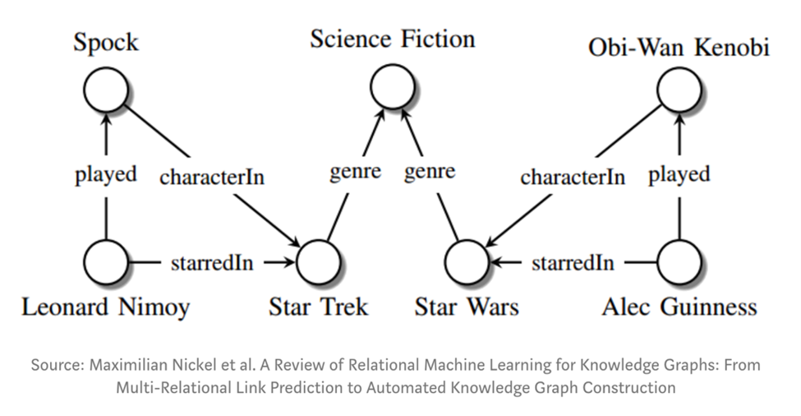
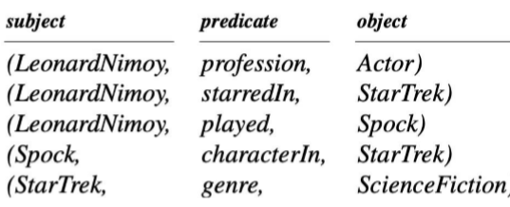
KNOWLEDGE BASED FAKE NEWS DETECTION
Knowledge representation as a set of (Subject,Predicate,Object) triples
“Leonard Nimoy was an actor who played the character Spock in the science-fiction movie Star Trek”
Vibhanshu Ranjan
Knowledge Graph(KG)

Slide 7
STYLE BASED FAKE NEWS DETECTION
Style Aspect
Text
Images
Visual Diversity
Visual Coherence
General Features
Latent Features
Visual Clarity
Visual Clustering
Rohit

Slide 8
STYLE BASED FAKE NEWS CLASSIFICATION
Style Classification
ML Models
DL Models
SVM
Random Forest
SAFE
EANN
XGBoost
Rohit

Slide 9
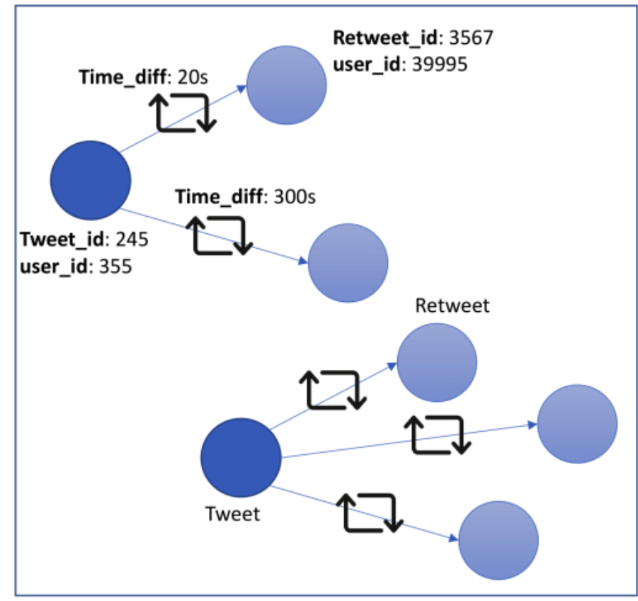
PROPAGATION BASED FAKE NEWS DETECTION
This method analyzes the spread of a post on social media networks.
A graph is created between the posts and reposts.
The nodes are posts and reposts.
The edge values define time difference between the original post and reposts.
Hrituraj Dutta 18EE35021
NEWS GRAPH G

Slide 10
FEATURES OF THE NEWS GRAPH
CLASSIFICATION
User Features
Number of followers
Number of following
Network features
Time difference
Number of tweets and retweets
Favourite count
Retweet Percentage
ML algorithms: Random Forest, Decision Tree,K nearest Neighbours, Logistic Regression
Geometric Deep Learning : Graph convolutional layer with topk pooling.
Hrituraj Dutta 18EE35021

Slide 11
CREDIBILITY BASED FAKE NEWS DETECTION
Credibility Aspect
Source
Content
Argumentation
Sentiments
Author
Co-Authors
Characters, Word
Readability
Shirsha Chowdhury

Slide 12
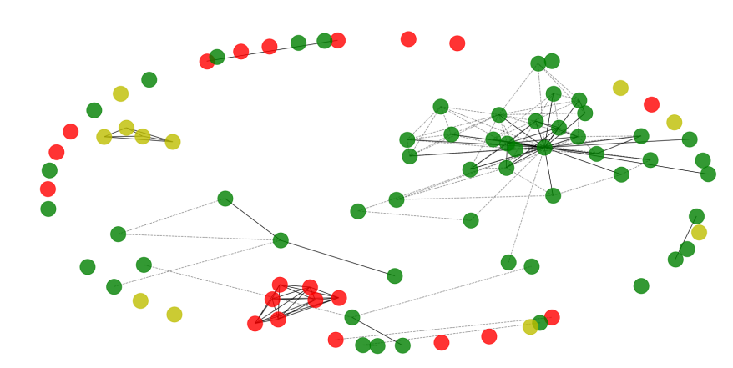
CREDIBILITY OF SOURCE
Is the Author Verified?
How many authors have written the Article?
Homophily Exists in Co Authorship network.
Authors Writing Authentic news doesn’t want to collaborate with authors writing Fake news.
Shirsha Chowdhury

Slide 13
CREDIBITY OF CONTENT
SENTIMENT ANALYSIS
FREQUENCY OF WORDS AND CHARACTER
ARGUMENTATION
READABILITY
Shirsha Chowdhury

Slide 14

THANK YOU

